Slide 1
Stepping up to
the Challenge
François-Régis Mouton
Director EU Affairs
2019

Slide 2
International Association of Oil & Gas Producers - IOGP
Oil/gas exploration & production
Refining
Transport
Marketing
Upstream
1

Slide 3
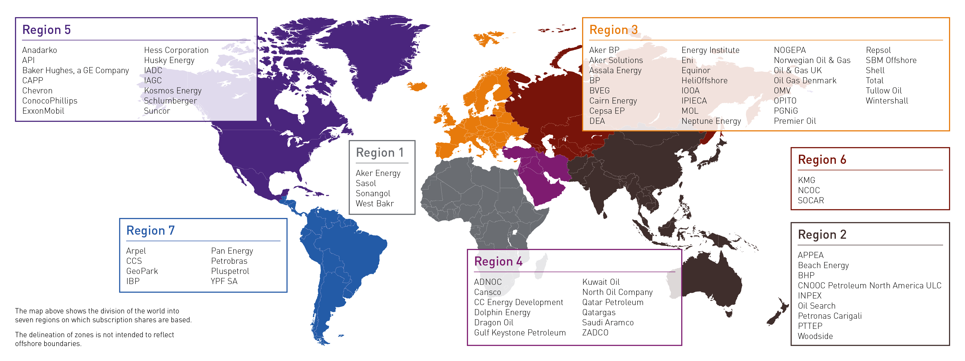
Global Membership
Map shows locations of Member Head Offices. Many operate globally
2

Slide 4
Does Europe Still Have Any Oil & Gas?

Slide 5
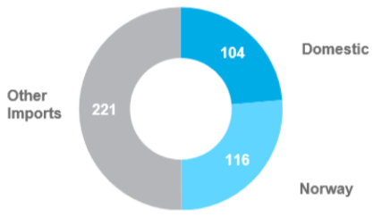
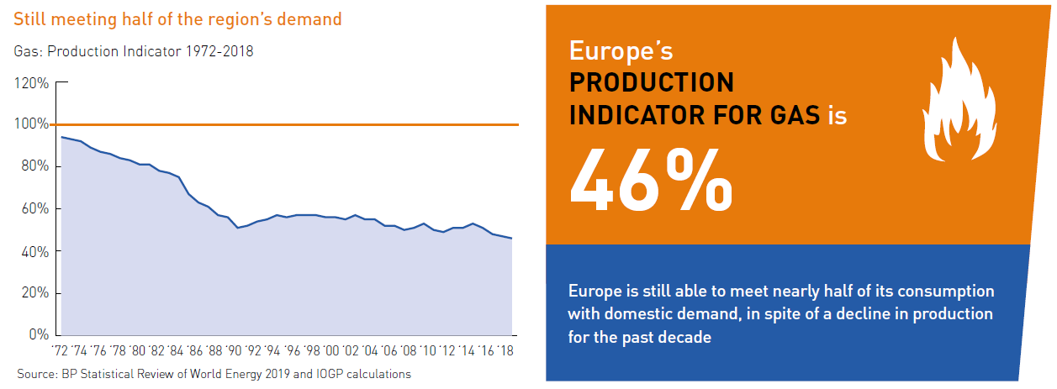
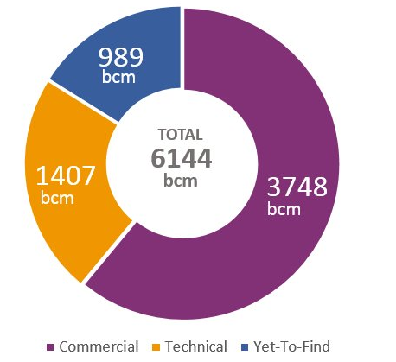
Gas – ½ of Europe’s needs are produced in Europe
EU28 + Norway Gas Supply Mix (bcm)
EU28 + Norway Gas Resources

Slide 6
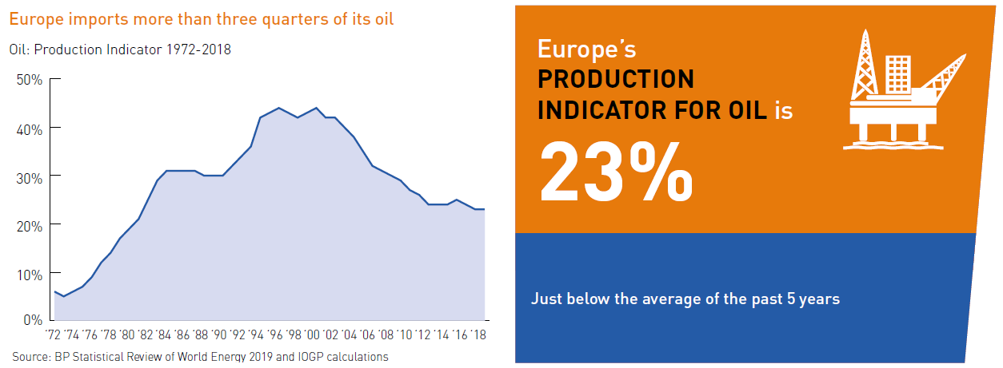
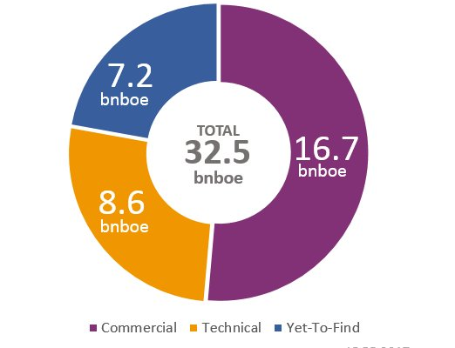
Oil – 1/4 of Europe’s needs are produced in Europe
EU28 + Norway Oil Resources

Slide 7
Energy Demand Today and in 2040
IEA 2018
Oil & Gas: 57%
IEA Sustainable Development Scenario
Oil & Gas: 35%
BIOMASS, BIOFUELS, BIOGAS 10%
WIND, SOLAR 3%
OIL 15%
WIND, SOLAR 20%
HYDRO 2%
OIL 33%
NUCLEAR 12%
GAS 20%
BIOMASS, BIOFUELS, BIOGAS 22%
COAL 14%
GAS 24%
COAL 4%
HYDRO 3%
NUCLEAR 16%

Slide 8
Getting Our House
in Order

Slide 9
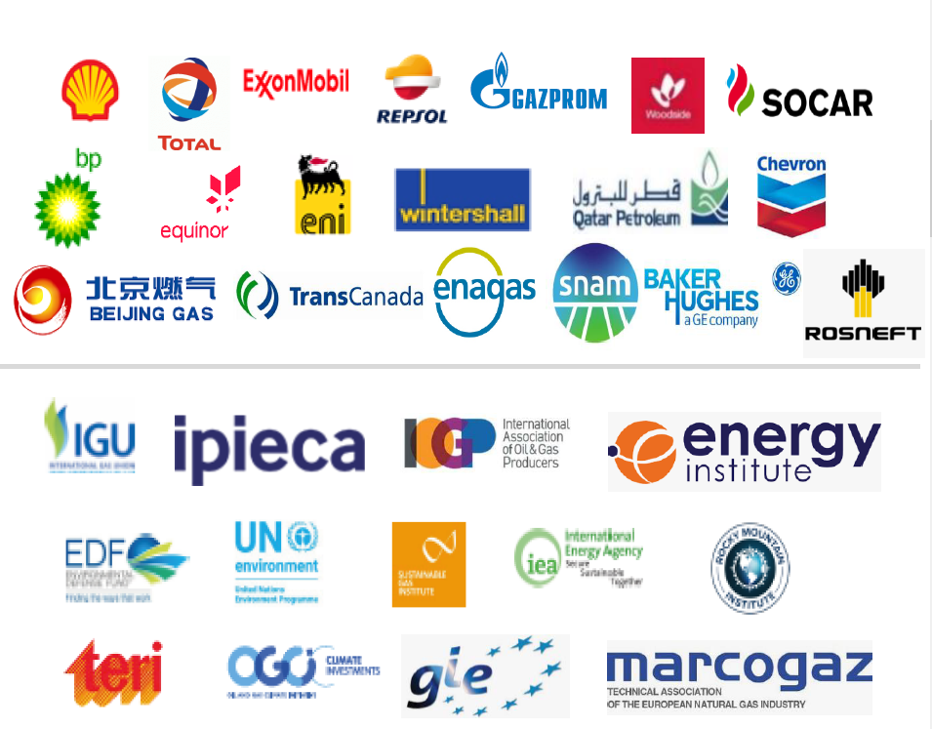
Methane Guiding Principles
The Guiding Principles on Reducing Methane Emissions across the Natural Gas Value Chain are:
Continually reduce methane emissions
Advance strong performance across gas value chains
Improve accuracy of methane emissions data
Advocate sound policy and regulations on methane emissions
Increase transparency
Growing support for the MGPs:
Started in November 2017 with 8 companies
Now 19 company signatories together with several supporting organisations
Notes:
We will do all we can to reduce our emissions, and we are the first to act.
Agriculture, waste, coal industry we have no idea about what they are really doing

Slide 10
Solutions for the
Long Term

Slide 11
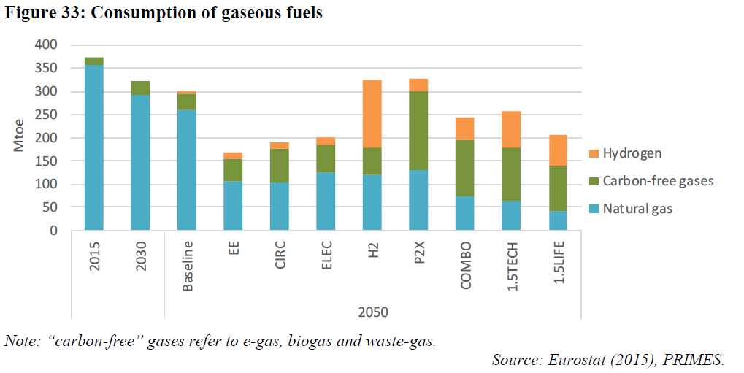
2050 Pathways: Hydrogen is key

Slide 12
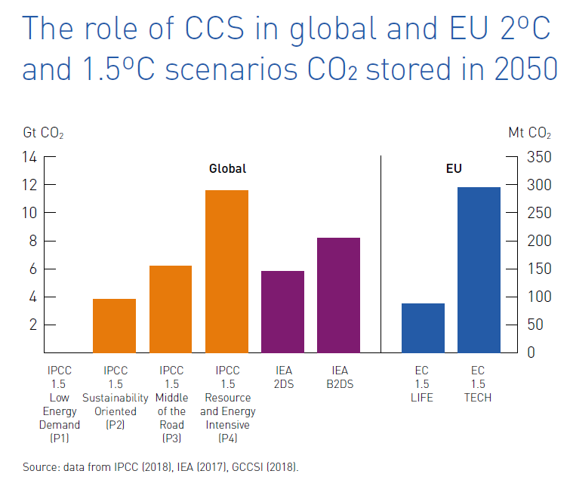
No Paris agreement objectives without CCUS
The IPCC, IEA and European Commission foresee an important role for CCS in meeting the Paris Agreement targets.
Today, there are 2 large-scale CCS facilities operating in Europe, capturing & storing 1.5 Mtpa CO2.
To be on track for 1.5°C, one CCS facility capturing 1.5 Mt CO2 would need to be added every week from now until 2050.
Window of opportunity:
Political support, but still in expert circles
Industry understands it’s now or never
3
Notes:
One scenario (1.5TECH) aims to further increase the contribution of all the technology options, and relies more heavily on the deployment of biomass associated with significant amounts of carbon capture and storage (BECCS) in order to reach net zero emissions in 2050. The second scenario (1.5LIFE) relies less on the technology options of 1.5TECH, but assumes a drive by EU business and consumption patterns towards a more circular economy. Similarly, the increase in climate awareness of EU citizens translates in lifestyle changes and consumer choices more beneficial for the climate. These include a continuation of the trend by EU consumers towards less carbon intensive diets, the sharing economy in transport, limiting growth in air transport demand and more rational use of energy demand for heating and cooling.
CCUS makes the third largest contribution to comulative CO2 reduction in the IEA Clean Technology scenario (nergy efficiency 39%, RES 36%, CCUS 13%, fuel switching 7%, nucelar 5%)

Slide 13
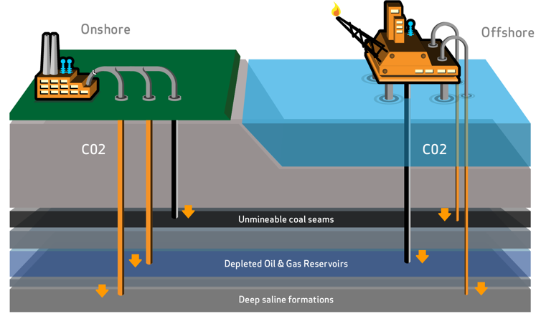
CCUS – How it Works

Slide 14
CCUS – The Potential

Slide 15
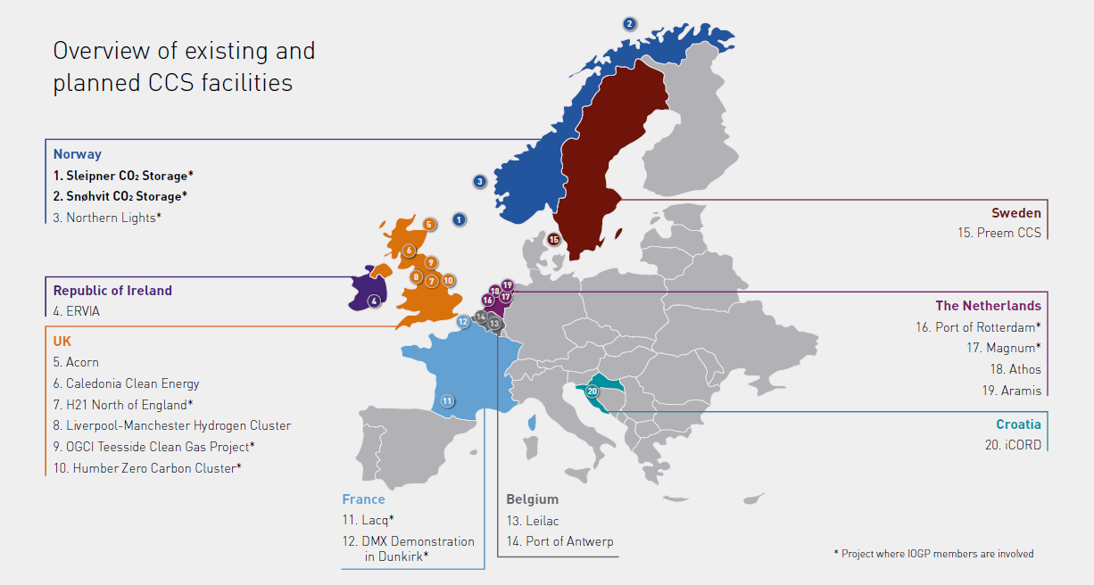
CCUS – More than a concept

Slide 16
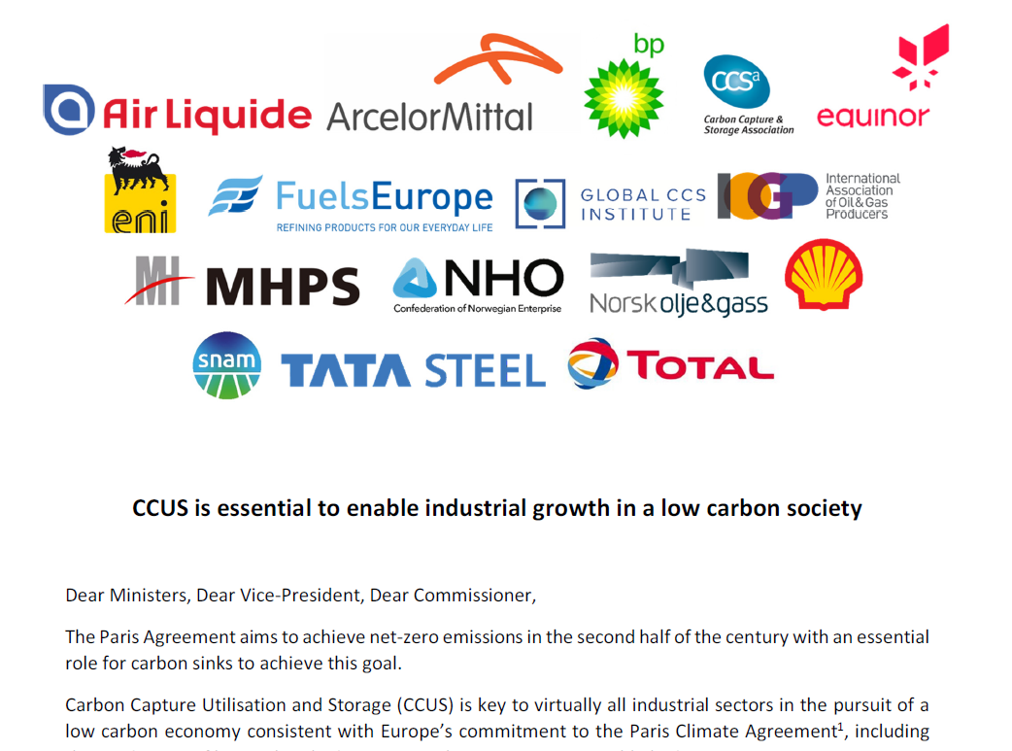
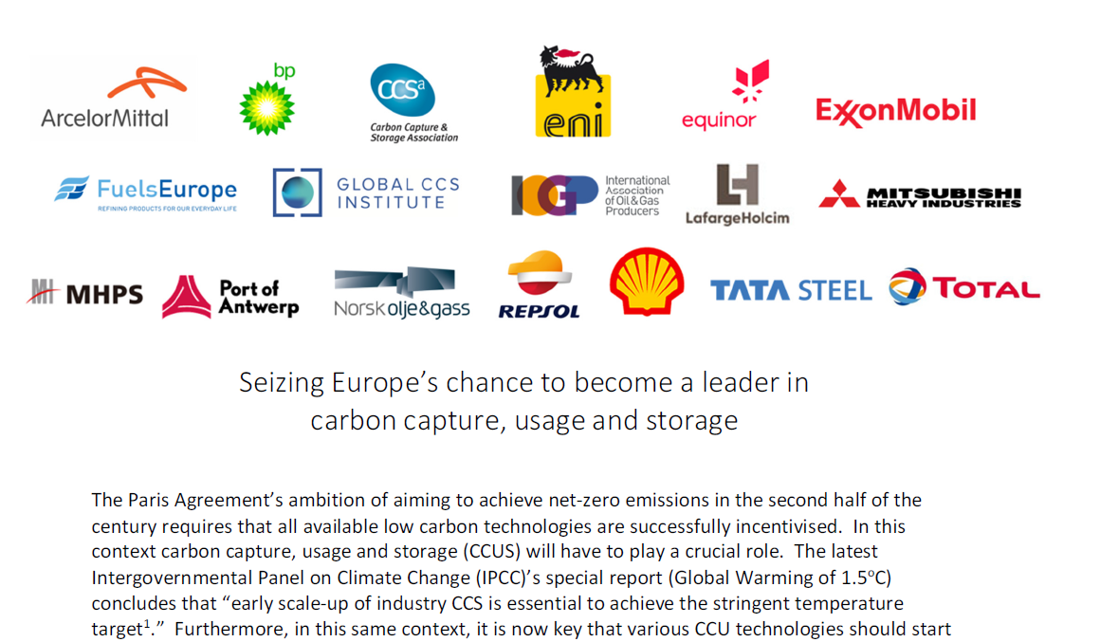
CCUS cannot be “just an oil & gas thing”

Slide 17
In Short !
Our industry’s action to support the EU’s climate ambition
Kickstart CCUS early deployment
Methane Emission Mitigation
Reduction of operational emissions
Progressive biogas & H2 injection into gas grid
LNG, CNG and low-carbon liquid fuels in transport
LNG in shipping
Energy Efficiency improvements
Large-scale deployment of CCUS
H2 value chain development with decarbonized natural gas
H2 in shipping
Low-carbon liquid fuels in aviation
Carbon sinks to offset emissions in hard-to-decarbonize sectors
Large-scale alternative and renewable energy deployment
2020
2030
2050
20% GHG Target
40-55% GHG Target
Net-Zero Emissions
What can the EU do?
Incentivize Coal to Gas & Renewables switch
Funding programmes for CCS, CCU, P2G and LCLF
Completion of Internal Gas Market & gas grid
Create markets for CCS, CCU and Hydrogen

Slide 18
MERRY CHRISTMAS !
François-Régis Mouton
Director EU Affairs
frm@iogp.org

